Slide 1

Department of Human Resources
New Performance Appraisal Forms Tutorial
Effective: January 2013

Slide 2
Introduction
Purpose
The purpose of this tutorial is to introduce the new Performance Appraisal format and how to understand it
Why are we changing them?
The Department of Human Resources periodically reviews our performance management process to ensure the appraisal process is streamlined and impactful. We conducted a pilot program with a variety of departments, and made final changes based on their feedback
Why do a Performance Appraisal?
Help employees clearly define and understand their responsibilities, provide criteria by which their performance will be evaluated and suggest ways in which they can improve performance. Helps managers distribute and achieve departmental goals

Slide 3
What has changed?

Slide 4
AMP Appraisal
Old
New
Structured Format
Document Addresses 6 Specific Categories
No Cover Sheet
Employee Submits a Summary of
Accomplishments
Unstructured Format
Narrative
Cover Sheet
Employee Submits a Summary of
Accomplishments

Slide 5
SP in Supervisory Positions Appraisal
New!
Previously done on the SP Appraisal Form
Old
New
SP Form
Evaluated on Critical Elements as
Determined by Supervisor
No Self Review
Same Format as AMP
Evaluated on 6 Specific Categories
Employee Submits a Summary of
Accomplishments

Slide 6
SP Appraisal Form
SP Probationary Appraisal Form
Old
New
Employee May Be Asked to Submit a Summary of Accomplishments
Evaluated on Critical Elements as Determined by the Supervisor and Established Performance Factors. Competencies are grouped into 4 Specific Categories
No Self Review
Evaluated on Critical Elements as
Determined by Supervisor and
Established Performance Factors
Simple Format with Areas for Comments

Slide 7
AMP
SP in Supervisory Positions
Appraisal Format

Slide 8
6 JOB PERFORMANCE/PROFESSIONAL COMPETENCIES:
  Job Knowledge/Job Skills/Quality of Work
  Organization/Time Management
  Communication/Leadership/Performance Management
  Customer Service/Team Work/Interpersonal Skills/Diversity
  Work Practice/Dependability
  Initiative/Problem Solving
Each competency reflects the skills, knowledge, and professional behavior necessary to perform the job in a competent, effective manner. Competencies were grouped together by relevance.
Don’t forget to review the approved goals from the previous year, discuss how effectively they were accomplished, & incorporate into the comments of each applicable job performance competency.

Slide 9
RATING SCALE.
Performance Level | Performance Level Definition
Outstanding | Performance that is characterized by exceptional accomplishments throughout the rating period and/or performance that is considerably and consistently at a significantly higher level than the established standards. Employee, on a regular and on-going basis, is typically innovative creative, and an excellent problem solver. The employee's performance has a very positive and demonstrable impact on the Department's ability to achieve its goals. The employee is consistently performing at the highest level of effectiveness.
Exceeds Expectations | Performance that for the majority of the rating period, is of a level higher than the established standards of the position. Employee often makes contributions that enhance the Department's ability to achieve its goals. The employee's performance is highly accomplished.
Meets Expectations | Performance that consistently meets the established standards of the position. The employee consistently achieves expected performance levels.
Needs Improvement | Performance that needs improvement in some aspects of the established standards of the position. The employee is inconsistent in meeting the standards of expectation. Immediate and sustained improvement is required. *Contact Human Resources Department for further assistance.
Below Standards | Performance that is substandard or incompetent and consistently fails to meet the established standards of the position. *Contact Human Resources Department for further assistance.
Achieves

Slide 10
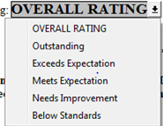
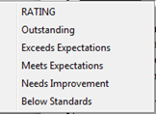
1. Job Knowledge/Job Skills/Quality of Work – Demonstrates the appropriate specialized knowledge required. Exhibits the
skills necessary to complete tasks using established techniques, materials, and equipment. This includes learning and adapting to
changing skills requirements…
For each of the 6 categories, Supervisors will describe the employee's performance, accomplishment of goals, and the impact on the Department and/or the University. They are to add specific comments using actual examples of performance and behaviors
If there are specific things the employee needs to improve upon, a brief development plan should be included
Comments:
(Required)
Development Plan:
(If Relevant)
RATING
Enter the appropriate rating from the scale provided

Slide 11
2. Organization/Time Management – Establishes clear objectives and sets priorities. Completes assignments in a thorough,
accurate, and timely manner that meets established/expected standards that enhance the Departments ability to meet its goals…
Comments:
(Required)
Development Plan:
(If Relevant)
Keep in mind, the definitions provided for each competency describe an employee that is performing at the "Meets Expectations" level
RATING
Enter the appropriate rating from the scale provided
3. Communication/Leadership/Performance Management – Effectively conveys information and ideas both orally and in
writing, which shares vision and initiates positive change. Listens carefully and seeks clarification to ensure understanding. Takes responsibility for facilitation information exchange among subordinates, peers and supervisors…
Comments:
(Required)
Development Plan:
(If Relevant)
RATING
Enter the appropriate rating from the scale provided

Slide 12
4. Customer Service/Team Work/Interpersonal Skills/Diversity – collaboration, and flexibility within the work
environment by exhibiting effective, consistent, and empathetic service to all FAU constituents...
Comments:
(Required)
Development Plan:
(If Relevant)
RATING
Enter the appropriate rating from the scale provided
5. Work Practices/Dependability – Takes responsibility for assigned (routine and non-routine) duties while displaying a positive/cooperative attitude toward work assignments and requirements…
Comments:
(Required)
Development Plan:
(If Relevant)
Supervisors will continue to describe the employee’s performance and accomplishment of goals by adding actual examples of performance and behaviors in each comment section. This should be done for all 6 categories
RATING
Enter the appropriate rating from the scale provided
6. Initiative/Problem Solving – Performs with minimal supervision, acts promptly, and seeks solutions to resolve
situations that arise…
Comments:
(Required)
Development Plan:
(If Relevant)
RATING
Enter the appropriate rating from the scale provided

Slide 13
Section 2: PERFORMANCE GOALS - List the agreed upon goals for the upcoming year.
Performance goals should support the overall mission of the Department, Division, and the University. Individual goals may be included, which provide for the employee's development of skills, abilities, and knowledge.
Performance
Goals
Use S.M.A.R.T. Goals:
Specific
Measurable
Attainable
Relevant
Timely
Routine Goals: Describe how to regular and ongoing activities
Problem Solving Goals: Describe activities designed to remedy problem situations that arise regularly
Problem Solving Goals: Describe activities designed to remedy problem situations that arise regularly
Innovative Goals: Describe activities that initiate or expand capabilities
Professional Growth Goals: Describe activities the employee can pursue for professional development that will enable them to perform the functions
of their position more effectively

Slide 14
Section 3: OVERALL PERFORMANCE RATING
Supervisor should review the individual ratings,
look at each Job Performance/Professional Competency, and determine the relative importance of each. Then decide what is a fair overall rating. The supervisor should be prepared to discuss the reasons for the ratings and be able to justify the decision for the overall rating

Slide 15
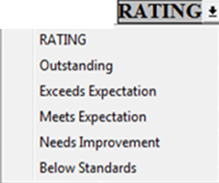
For an Overall Rating
of
Needs Improvement or Below Standards
Call Employee Relations at 7-2554 before completing the process ***********************************
It is very important supervisors work with Human Resources on a Needs Improvement or Below Standards appraisal. A special appraisal is always used as a follow-up to an overall rating of “Below Performance Standards”. The Employee Relations Services team in Human Resources will work closely with the supervisor in preparing a detailed addendum to the appraisal and to establish a plan of action for correcting performance issues.
A follow up special appraisal should be completed 60 days from the date the “Below Standards” appraisal was issued.

Slide 16
SP Appraisal Format

Slide 17
SP
4 JOB PERFORMANCE COMPETENCIES
  Job Knowledge/Job Skills/Quality of Work
  Quantity of Work/ Organization/Time Management
  Work Practices/Dependability
  Customer Service/Teamwork/Interpersonal Skills/Diversity
Each competency
reflects the skills, knowledge, and professional behavior
necessary to perform the job in a competent, effective manner. Competencies are grouped together by relevance

Slide 18
Job Knowledge/Job Skills/Quality of Work – Demonstrates the appropriate specialized knowledge required. Exhibits the skills necessary to complete tasks using established techniques, materials, and equipment. This includes learning and adapting to changing skill requirements…
  CRITICAL ELEMENTS:
  CRITICAL ELEMENTS are those tasks which the supervisor determined were most important to the overall job performance during the appraisal period. Summarize up to FIVE Critical Elements. Put them in priority order keeping in mind their level of importance and the amount of time spent on each. For each element, comment on the employee’s job knowledge, job skills and quality of work, as described above.
  1.
  Comments:
  2.
  Comments:
  3.
  Comments:
  4.
  Comments:
  5.
  Comments:
Similar to the previous SP format, Supervisors will list up to 5 Critical Elements under the first Job Competency
RATING
Enter the appropriate rating from the scale provided

Slide 19
Continued - Section 1: JOB PERFORMANCE/COMPETENCIES -
2. Quantity of Work/Organization/Time Management – Completes assignments in a thorough, accurate, and timely manner that meet established and expected standards and enhance the Department's ability to meet its goals…
Supervisors will describe the employee's
performance, accomplishment of goals, and the impact on the Department and/or the University specific comments using actual examples of performance and behaviors
If there are specific things the employee needs to improve upon, a brief development plan should be included here
Comments:
(Required)
Development Plan:
(If Relevant)
RATING
Enter the appropriate rating from the scale provided

Slide 20
Continued - Section 1: JOB PERFORMANCE/COMPETENCIES -
3. Work Practices/Dependability - Displays a positive and cooperative attitude toward work assignments and requirements.
The employee takes responsibility for assigned duties…
Comments:
(Required)
Development Plan:
(If Relevant)
Supervisors will continue to describe the employee's performance, and any relevant development plan for all 4 competencies
RATING
Enter the appropriate rating from the scale provided
4. Customer Service/Teamwork/Interpersonal Skills/Diversity - Exhibits effective, consistent, and empathetic service to
all FAU constituents, including students, parents, faculty, staff and all others serviced by the University…
Comments:
(Required)
Development Plan:
(If Relevant)
RATING
Enter the appropriate rating from the scale provided

Slide 21
Section 2: PERFORMANCE GOALS - Optional
This section is OPTIONAL, however, establishing written goals is a good way to involve the employee in what is expected for the upcoming year
Performance
Goals
If so, Supervisors and employees are encouraged to use S.M.A.R.T. Goals:
Goals that are Specific, Measurable, Attainable, Relevant, and Timely
Routine Goals: Describe how to enhance regular, ongoing activities
Problem Solving Goals: Describe activities designed to remedy problem situations that arise regularly
Innovative Goals: Describe activities that initiate or expand capabilities
Professional Growth Goals: Describe activities the employee can pursue for professional development that will enable them to perform the functions of their position more effectively

Slide 22
Section 3: OVERALL PERFORMANCE RATING
Supervisors should review the individual ratings,
look at each Job Performance/Professional Competency, and determine the relative importance of each. Then decide what is a fair overall rating
Supervisors should be prepared to discuss the reasons for the ratings and be able to justify the decision for the overall rating

Slide 23
For an Overall Rating
of
Needs Improvement or Below Standards
Call Employee Relations at 7-2554 before completing the process
***********************************
It is very important supervisors work with Human Resources on a Needs Improvement or Below Standards appraisal. A special appraisal is always used as a follow-up to an overall rating of “Below Performance Standards”. The Employee Relations Services team in Human Resources will work closely with the supervisor in preparing a detailed addendum to the appraisal and to establish a plan of action for correcting performance issues.
A follow up special appraisal should be completed 60 days from the date the “Below Standards” appraisal was issued

Slide 24
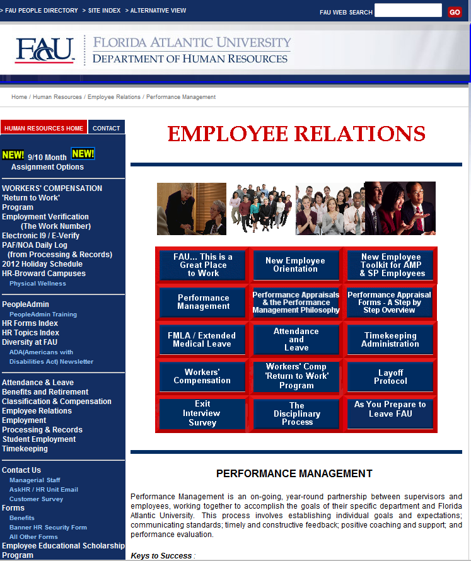
New forms available
January 2013
Both the previous version and the new version will be available online, January 2013. Old forms will be removed from the website on March 1, 2013
If you would like more information on Performance Management, please also visit the Performance Management Philosophy section, and watch for upcoming training sessions in March 2013

Slide 25
Questions?
Nancy Vincenty, Broward HR Manager
Davie: 954 236-1245
Fort Lauderdale: 954 762-5686
nvincen6@fau.edu
  Donna Newman, Employee Relations
  & Development Manager
  561 297-2554
  newmand@fau.edu
            Robin Kabat, Associate Director
            561 297-3072
            kabat@fau.edu

