Slide 1
Adjunct and GTA Credentialing Process
Created by Felipe Vargas

Slide 2
GOALS
PROVIDE AN OVERVIEW OF THE CREDENTIALING PROCESS FOR ADJUNCTS AND GTA’S.
PROVIDE WIZARD ACCESS AND NAVIGATION
RESPONSABILITIES
WHAT MAKES A TRANSCRIPT OFFICIAL
TRANSCTRIPT REQUEST PROCESS
CREDENTIALING CALENDAR

Slide 3
LET’S GET STARTED!
The process starts at the department as this is your hire.
Access to the Wizard (https://wizard.fau.edu/)
Official Transcript
Signed offer letter (https://www.fau.edu/hr/recruitment-services/amp-and-sp-hiring-process/)
Sample Syllabus
Curriculum Vitae

Slide 4
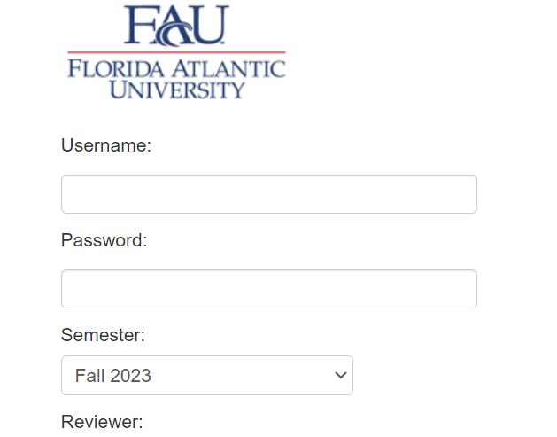
Wizard
The Wizard is a program used to credential adjuncts and GTA’s.
The Wizard only works on University connected computers or via VPN.
For VPN requests visit (https://www.fau.edu/oit/security/vpn/)
https://wizard.fau.edu/

Slide 5
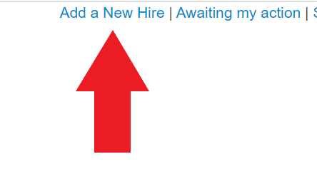
Wizard Credentialing Process
Department
Chair and/or Dean
Provost
IOR available for Schedule

Slide 6
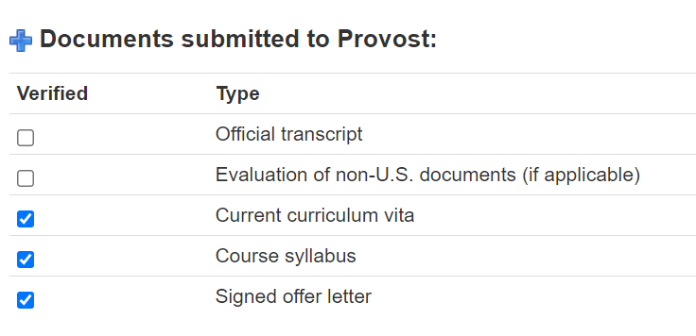
Process Flow at the Department
Must enter hire into the Wizard
Hires are credentialed per course, and not as a whole.
Each course taught must be entered separately.
Must attach the CV, Sample Syllabus, and Signed Offer letter on every entry.
To Request access please email fvargas@fau.edu

Slide 7
Process workflow at the Department continued…
Individuals can be credentialed via the following avenues:
Terminal Degree in Discipline
Other terminal degree - credential by research/experience/creative activity
Other terminal degree - credential by coursework
Other terminal degree - credential by coursework and research/experience/creative activity
Masters degree
Bachelors degree

Slide 8
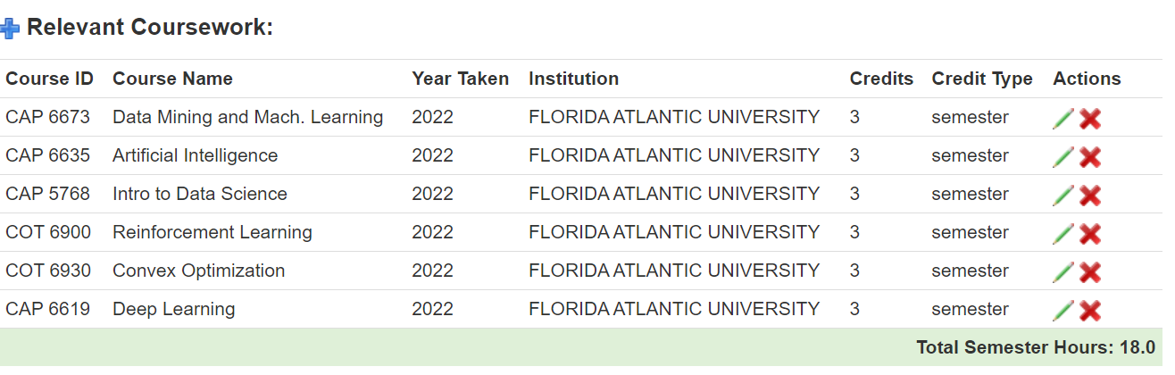
Process workflow at the Department continued…
All hires apart from individuals with Terminal Degrees must have 18 relevant credits listed in the Relevant Coursework.

Slide 9
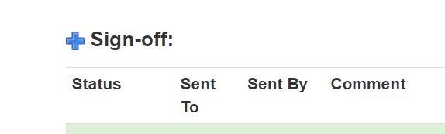
Process workflow to the Provost
The Wizard operates similarly to WorkDay as items are moved as they are approved.
Hires must be fully approved at the college level
All information must be entered accordingly or will be sent back for corrections.
An Official transcript is needed for evaluation

Slide 10

OFFICIAL TRANSCRIPTS – SACSCOC REGULATIONS
Physical
Must arrive directly from issuing institution in a closed envelope.
Cannot be addressed the student (hire).
Can be opened at the department for inspection.
Must follow other SACSCOC regulations
Electronic
Must arrive directly from issuing institution (Registrars Office).
Cannot be addressed the student (hire).
Can be opened at the department for inspection.
Must follow other SACSCOC regulations

Slide 11

What about foreign earned degrees?
They will need to be evaluated by a NACES agency.
https://www.naces.org/members
NACES agency send evaluations directly to department
Verifications of education forms are not to be used for credentialing purposes.
It is the hires responsibility to handle their respective degree evaluation.

Slide 12
NACES evaluations for nonterminal degrees
NACES evaluations for nonterminal degrees will need a detailed course evaluation.
Nonterminal degrees must list 18 credits of relevant course work in the Wizard.

Slide 13
Helpful information from SACSCOC
Faculty teaching baccalaureate courses: doctoral or master’s degree in the teaching discipline or master’s degree with a concentration in the teaching discipline (minimum of 18 graduate semester hours in the teaching discipline). At least 25 percent of the discipline course hours in each undergraduate major are taught by faculty members holding the terminal degree—usually the earned doctorate—in the discipline.
3000-level course, the IOR needs to have a completed Masters degree at a minimum.
The click here for the Provost Credentialing Manual

Slide 14
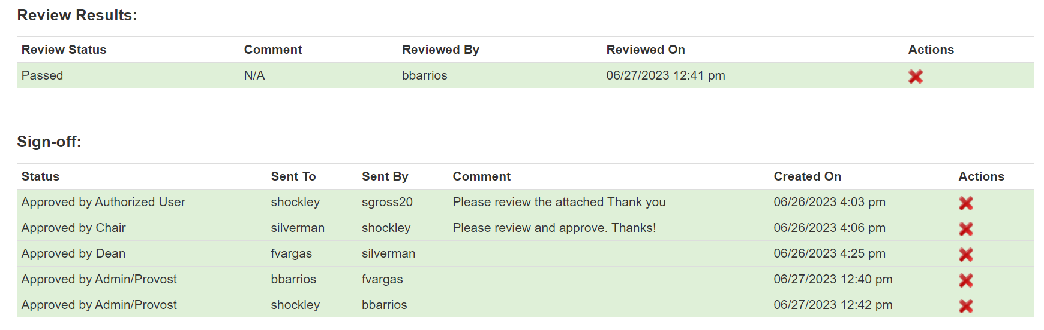
Credential Review
It takes up to 24 hours for the hire to be added into the schedule as soon as it has been ultimately approved by Dr. Barclay Barrios.

Slide 15
Internal Transcript Request (FAU only)
I can assist in obtaining official transcripts for adjuncts and GTA’s to no cost. You will need to email fvargas@fau.edu the following details:
  Full Name
  Z#
  Once the transcript is ready the department will have to pick it up. This process has a turnaround of less than 48 hours.

Slide 16
CREDENTIALING CALENDAR
Starting Spring 2024 we will unveil the new credentialing calendar.
Keep us on track.
Key dates:
  Dec 12: Last day to request transcripts
  Dec 15: Last day to guarantee credentialing pending review
December |  |  |  |  |  | 2023
MONDAY | TUESDAY | WEDNESDAY | THURSDAY | FRIDAY | SATURDAY | SUNDAY
27 | 28 | 29 | 30 | 01 | 02 | 03
04 | 05 | 06 | 07 | 08 | 09 | 10
11 | 12 | 13 | 14 | 15 | 16 | 17
 |  | LAST DAY TO REQUEST GTA/ADJUNCT TRANSCRIPTS |  | LAST DAY TO GUARANTEE CREDENTIALING
18 | 19 | 20 | 21 | 22 | 23 | 24
 |  |  |  | LAST DAY OF LABOR
25 | 26 | 27 | 28 | 29 | 30 | 31

Slide 17

CREDENTIALING CALENDAR MOVING FORWARD
April |  | Summer |  |  |  | 2024
MONDAY | TUESDAY | WEDNESDAY | THURSDAY | FRIDAY | SATURDAY | SUNDAY
01 | 02 | 03 | 04 | 05 | 06 | 07
08 | 09 | 10 | 11 | 12 | 13 | 14
15 | 16 | 17 | 18 | 19 | 20 | 21
 |  | LAST DAY TO REQUEST TRANSCRIPTS |  | LAST DAY TO GUARANTEE CREDENTIALING
22 | 23 | 24 | 25 | 26 | 27 | 28
29 | 30 | 01 | 02 | 03 | 04 | 05
Deadline: 22 days prior to the start of a semester.
Guarantees IOR makes it into the schedule
After deadline we cannot guarantee individual will make it into the schedule.

Slide 18
FALL 2024
July |  |  |  |  |  | 2024
MONDAY | TUESDAY | WEDNESDAY | THURSDAY | FRIDAY | SATURDAY | SUNDAY
01 | 02 | 03 | 04 | 05 | 06 | 07
08 | 09 | 10 | 11 | 12 | 13 | 14
15 | 16 | 17 | 18 | 19 | 20 | 21
22 | 23 | 24 | 25 | 26 | 27 | 28
 |  | LAST DAY TO REQUEST TRANSCRIPTS |  | LAST DAY TO GUARANTEE CREDENTIALING
29 | 30 | 31 | 01 | 02 | 03 | 04

Slide 19
Helpful links
Credentialing Manual
Academic Calendar
NACES
SACSCOC – Principles of Accreditation
SACSCOC – Resource Manual
Wizard Link

Slide 20
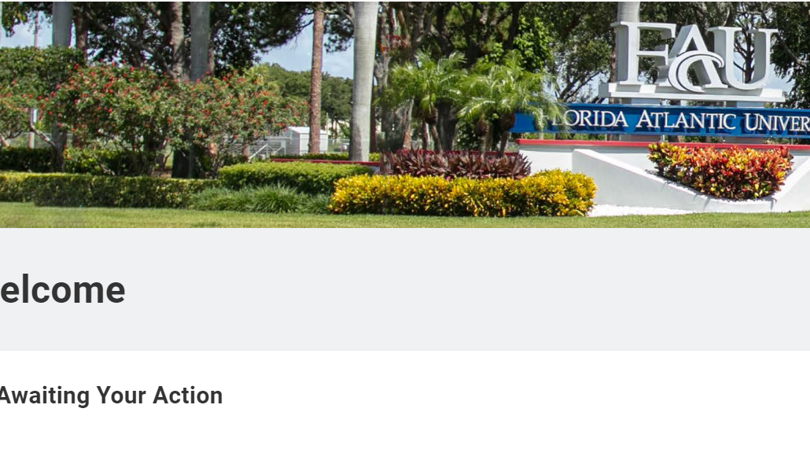
FULL TIME NEW HIRES AND CREDENTIALING
PROCESS STILL STARTS AT DEPARTMENT
PLEASE SEND PACKETS TO SKANE2021@FAU.EDU
NOT CREDENTAILED IN THE WIZARD
OFFICIAL TRANSCRIPTS

