Slide 1
New Faculty Orientation
Aug. 12, 2025

Slide 2
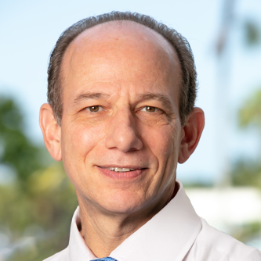
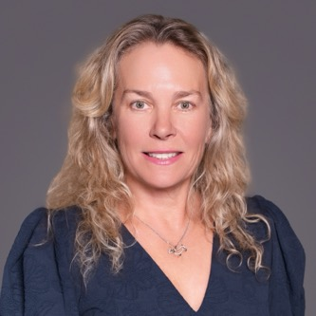
Office of the Vice President for Research
Gregg B. Fields, Ph.D., FNAI Vice President fieldsg@fau.edu
Cheryl Krause-Parello, Ph.D., RN, FAAN Associate Vice President
ckrausep@health.fau.edu
Contact: fau.research@fau.edu
fau.edu/research

Slide 3
Division of Research Welcome Session
Wednesday, September 10th 2:00 - 3:15 PM Board of Trustees meeting room 305 – Administration Building Boca Campus
Meet with fellow new faculty members and Division of Research (DoR)
unit leads to gather key information that will aid you as you embark on your research and scholarship journey at FAU.
RSVP by emailing proposaldevelopment@fau.edu This is an in-person event, but a Zoom option will be available for faculty who are unable to attend.

Slide 4





OFFICE OF RESEARCH DEVELOPMENT SERVICES
Funding Opportunities
Monthly bulletin in Research Link
Custom searches to match topic and expertise
Targeted alerts
Proposal Consultation and Development
Agency and opportunity match
Concept development, proposal editing and review
Links to collaborators
Programs and Events
Onboarding and proposal-specific programs
Networking and collaboration events
Resources
ORD Canvas Site
Boilerplates
Grant-writing guidance and tools
Limited Submissions
Limited funding opportunities
Limited submission tickets
Internal competition panel reviews

Slide 5
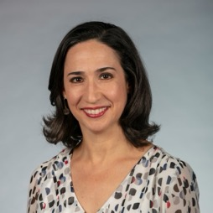


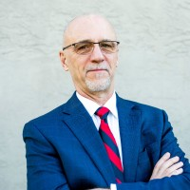

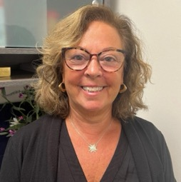
OFFICE OF RESEARCH DEVELOPMENT PROGRAMS
Alice Miehl Director, Research Programs/Services
Events: Research Renewal and Research Connections.
Early Career Launchpad (ECL)
ENROLL BY 9/12
Annually during Fall semester
Onboarding, networking and research development for “early career” principal investigators (PIs)
Proposal Development Liftoff (PDL)
SPRING 2026
Targeted proposal writing
Review by experienced researchers and scholars
NSF CAREER Proposal Preparation Program
SPRING 2026
Deep dive on best practices
Consultancy from external and internal CAREER awardees
Steve Gregg Assistant Director, Research Programs /Services
Sandy Siegman Specialist, Research Programs/Services

Slide 6
OFFICE OF SPONSORED PROGRAMS
Serve as FAU’s Institutional Authorizing Official
Provide Quarter and Annual Reports and Metrics
Updates Policies and Procedures
Manage Novelution system
Conduct Information Sessions
Provide training and workshops
Distribute sponsor/research updates and announcements
Negotiate contract terms & conditions
Prepare and process Sponsored Research Agreements
Liaison between the PI, legal counsel and Sponsor
Prepare and process non-financial agreements (NDAs, MOUs)
Issue outgoing subawards and other agreements

Slide 7
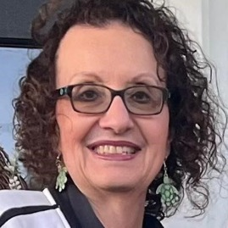
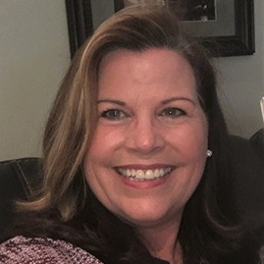
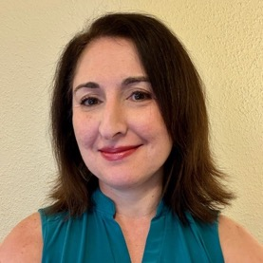
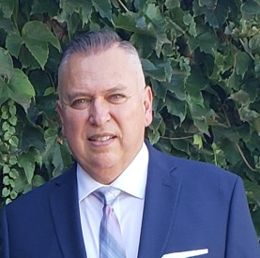
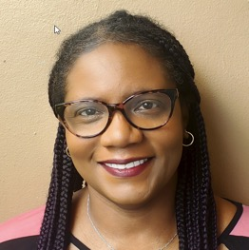
OFFICE OF SPONSORED PROGRAMS WHO WE ARE
Miriam Campo Associate Vice President
Nancy Thoman Executive Director
Lori DeMartino Associate Director, Proposal Services
Efrain Arroyo Associate Director, Contract Services
Patrice Cochran Associate Director, Award Services
sponsoredprograms@fau.edu
fau.edu/research/sponsored-programs

Slide 8
Research Integrity
Human Subjects Protection (IRB)
Animal Care and Use (IACUC)
Research Misconduct
Institutional Biosafety Committee (IBC)
Responsible Conduct of Research (RCR)
Financial Conflict of Interest (FCOI)

Slide 9
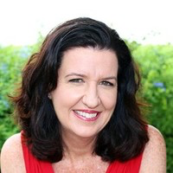
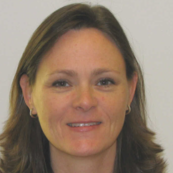
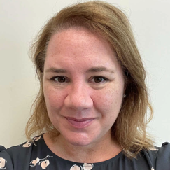
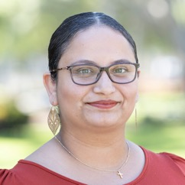
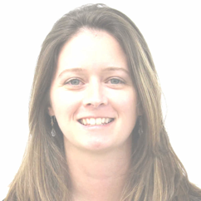
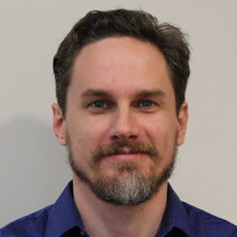
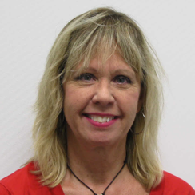
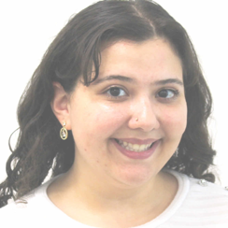
RESEARCH INTEGRITY WHO WE ARE
Elisa Gaucher Associate Vice President
Kristen Ware Senior Associate Director
Cortni Romaine Senior Associate Director
Judith Martinez Platform and Training Manager
Dana Becker Assistant Director, IACUC
Andrew Donovan Coordinator II, IBC and FCOIC
Donna Simonovitch Senior Manager, HRPP and IRB
Daniela Esquenazi Research Compliance Specialist
fau.edu/research-admin/research-integrity

Slide 10
Comparative Medicine
Ethical and humane animal use
Facilitation of high- quality pre-clinical research
Compliance Support:
Veterinary reviews of animal use protocols
Training and documentation
SOP Development
Research Services:
Animal Procurement
Animal model development
Breeding colony management
Technical services and training
State-of-the-art animal care
Veterinary Care
Cutting edge animal housing and monitoring
Health surveillance
Environmental enrichment

Slide 11
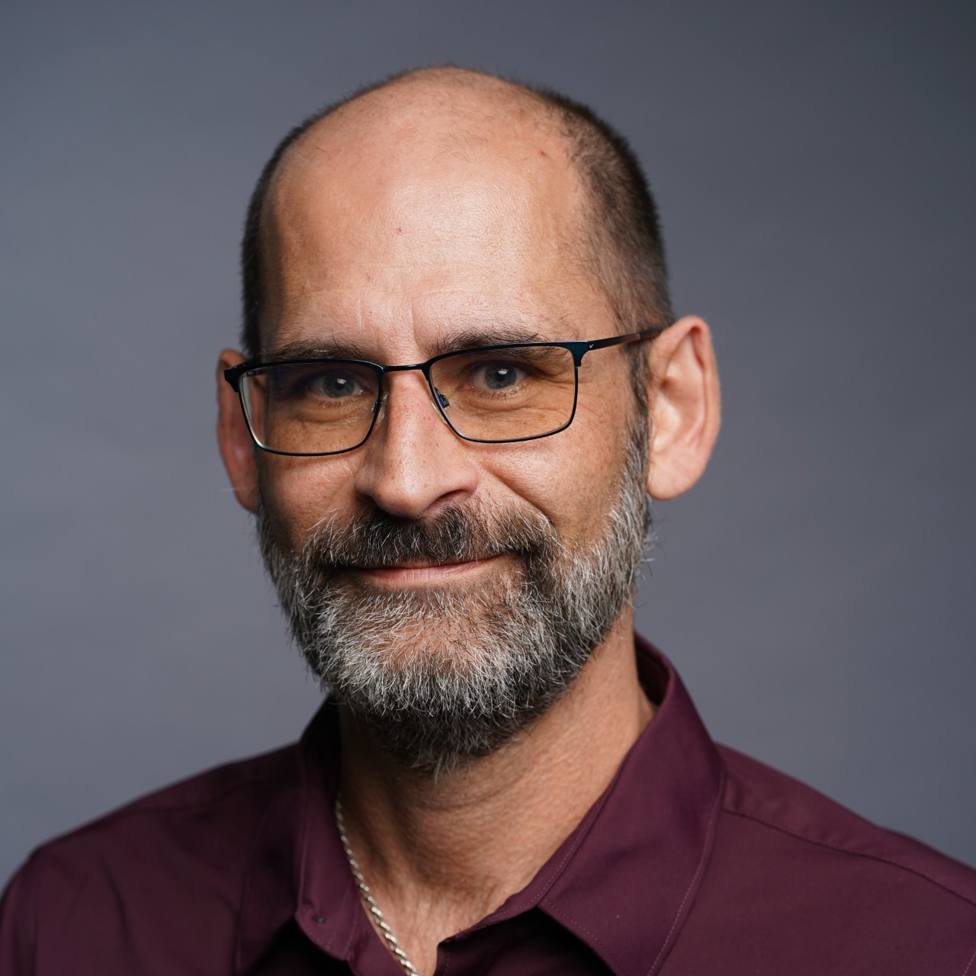
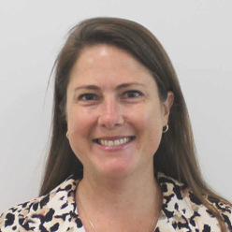
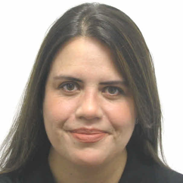
COMPARATIVE MEDICINE WHO WE ARE
Nicole Compo Attending Veterinarian ncompo@fau.edu
Robbie Champion Director jchampion@fau.edu
Helen Munchow Associate Director amunchow@fau.edu
fau.edu/research/comparative-medicine

Slide 12
RESEARCH ACCOUNTING
Financial Compliance and Audits
Award/ Account and Budget Setup
Financial Reporting
Invoicing and Collections
Effort Reporting and Subaward Monitoring
Expenditure Approval and Oversight
Award Closeout

Slide 13
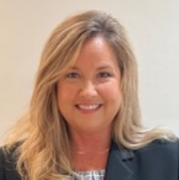
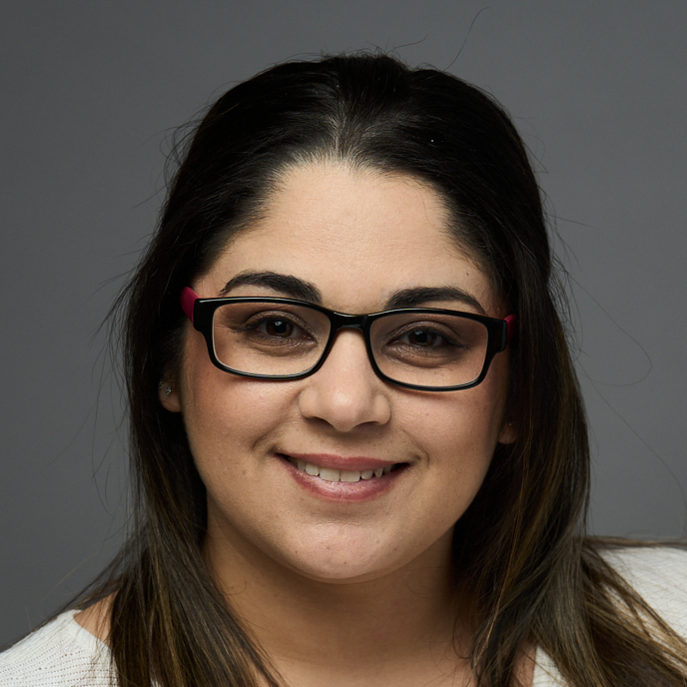
OFFICE OF RESEARCH ACCOUNTING WHO WE ARE
Heather Saunders Executive Director
Michael Simcox Senior Associate Director
Justine Cupo Associate Director
Jessica Gallardo Research Accounting Manager
researchaccounting@fau.edu
fau.edu/research-admin/research-accounting

Slide 14
Office of Research Finance
DOR and Institutes Operational Budgets
Florida Atlantic Research Corporation
F&A and Fringe Rate Agreements / Reinvestments

Slide 15
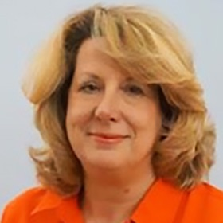
OFFICE OF RESEARCH FINANCE WHO WE ARE
Contact:
researchfinance@fau.edu
fau.edu/research-admin
Lynn Asseff Associate Vice President lasseff@fau.edu

Slide 16




RESEARCH COMMUNICATIONS SERVICES
Assign News
Interview
Writing/Editing
Design
Photography
Video/Animation
Graphics
Marketing
Social Media
Eblast
Advertisements
Distribution
Digital
Web
Print

Slide 17
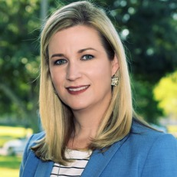
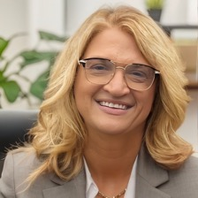
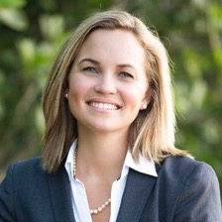
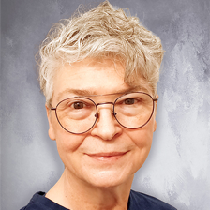
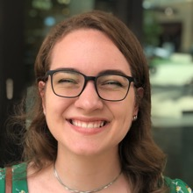
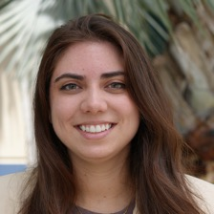
RESEARCH COMMUNICATIONS WHO WE ARE
Cara Perry Associate Vice President
Cammi Clark, Ph.D. Senior Director
Chelsey Matheson Associate Director
Lillian Cozart, MA Assistant Director of Web Development
Kasia Bytnar Assistant Director of Multimedia
Paige Arriola Assistant Director of Multimedia
fau.edu/research/comparative-medicine

Slide 18
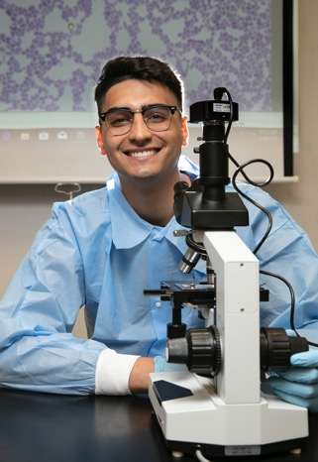
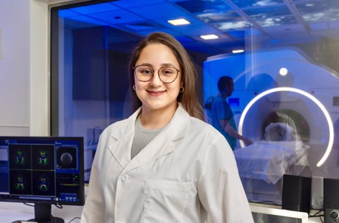
Research Cores
What are Research Cores?
Centralized facilities for shared research resources
Access to advanced instruments, technologies, expert staff and services
Enable cutting-edge research while saving time and money
Key Benefits
Ideal for new PIs with limited resources
Access to expertise and capabilities not found in most labs
Avoid duplicate equipment purchases
Support repairs for critical equipment
Strengthen grant proposals with advanced capabilities
Available Research Cores
Advanced Cell Imaging Core
Biostatistics Collaborative Core
Clinical Research Unit
Comparative Medicine
Engineering and Technology Core
MRI Research & Discovery Center
Neurobehavior Core
Water Analysis Lab

Slide 19
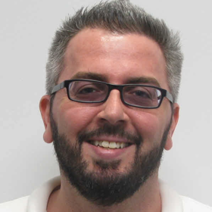
RESEARCH CORES WHO WE ARE
Research Cores Internal Pilot Award Program
Access to Florida Atlantic Core services for projects that have the potential of being externally funded
Awards ranging from $500 – $5,000
Thomas Graziano Director tgrazian@health.fau.edu
Contact:
researchcores@fau.edu
fau.edu/research-admin/cores

Slide 20
Office of Technology Development
Our Services
Evaluate new intellectual property
Secure patent, copyright and trademark protection
Develop marketing and commercialization strategies
Build partnerships with corporations and investors
Negotiate options, licenses and related agreements
Assist faculty, staff and student startup companies
Provide outreach and education services
Our Programs
Florida Atlantic Wave Competition
Market Validation Workshop
Technology Development Internship Program
Owl Innovator Workshop Series
Innovation Pilot Award Program
National Academy of Inventors Chapter

Slide 21
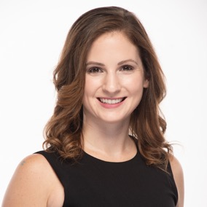
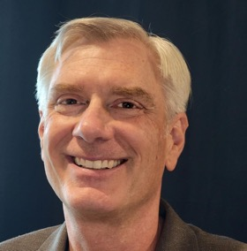
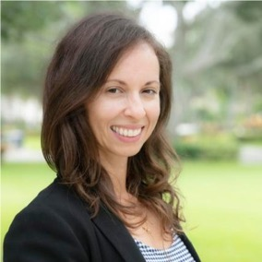
OFFICE OF TECHNOLOGY DEVELOPMENT WHO WE ARE
Dana Vouglitois, JD Senior Associate Director
Chris Houghtaling, MBA Research Commercialization Specialist
Regina Thompson, MBA Assistant Director of Strategic and Economic Initiatives
fau.edu/research/comparative-medicine

Slide 22
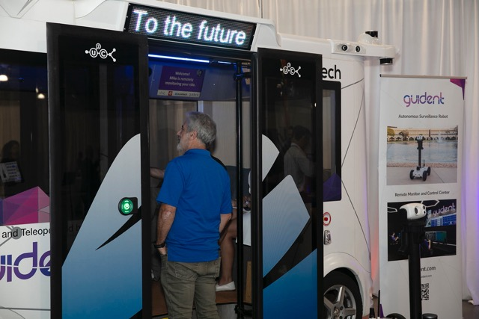
The Runway at Florida Atlantic EARLY-STAGE BUSINESS INCUBATOR/ACCELERATOR
Our Services
Entrepreneurial education
Team-based mentoring
Intern support
Capital raising assistance
Networking events
Specialty Services (attorney, accounting, development)
Opportunities to win cash

Slide 23
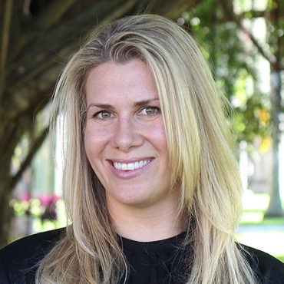
THE RUNWAY AT FLORIDA ATLANTIC WHO WE ARE
Jessica Beaver Associate Director jbeaver@fau.edu
Contact:
therunway@fau.edu
fau.edu/therunway

Slide 24
Any Questions?

