Slide 1

things you need to know
Presented by Associate Provost, STEPHEN ENGLE &
SENIOR UNIVERSITY counsel, tori Winfield

Slide 2
OVERVIEW
Collective Bargaining Agreement
  Article 5 Academic Freedom & Responsibility
  Article 6 Nondiscrimination
  Article 10 Performance Evaluations
  Article 17 Leaves
  Article 19 Conflict of Interest/ Outside Activity & Appendix J
  Article 24 Benefits
Instruction
Faculty Absence
Florida Sunshine Laws

Slide 3
Bargaining unit
≈ 920 in-unit members
Positions vary:
  Visiting instructors → full professors
  Librarians, psychologists & K-12 teachers
Article 30 (Duration): Agrees to a 3-year CBA ending June 30, 2028.

Slide 4
Article 5 academic freedom & responsibility
When teaching or engaging in assigned duties, faculty shall provide an objective and skillful exposition of subject matters, including a variety of scholarly opinions.
Faculty have the academic responsibility to act respectfully towards members of the University community to include refraining from statements disparaging the professional capabilities of colleagues and others.
Contributing to the orderly and effective functioning of the academic unit and/or the University.
Responsibility not to represent oneself as an institutional representative, unless specifically authorized as such.

Slide 5
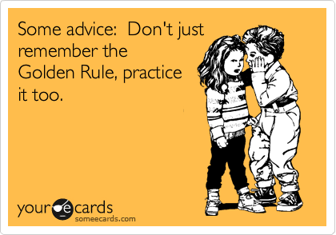
Collegiality & effective communication
Remember, this is a long-term relationship.
What goes around, comes around
Communication with Chair/Director is important
University Policy 8.2, Standards of Conduct

Slide 6
Article 6 nondiscrimination
The Office of Civil Rights and Title IX (OCR9) is charged with investigating charges of discrimination and harassment, and determining whether a violation of University Policy 1.15 or other University regulations and policies occurred. However, independent of the OCR9’s determination, the employee may be disciplined pursuant to Article 16 if factual findings suggest the employee is incompetent or engaged in misconduct. A record of such discipline will be placed in the employee’s evaluation file.
Mandatory reporting – All claims of discrimination and harassment based on membership in a protected class must be reported to OCR9.
Student Accessibility Services (SAS)

Slide 7
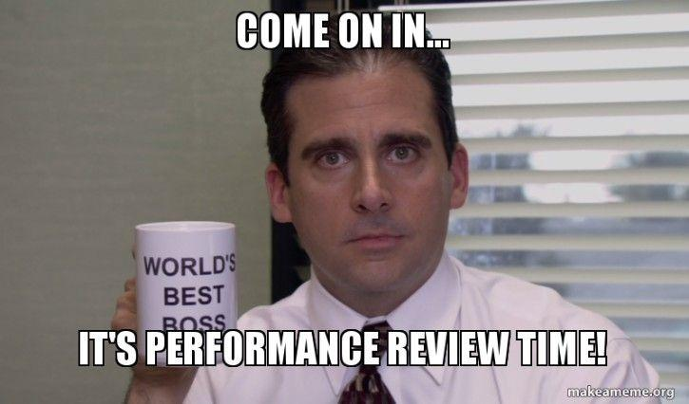
Article 10 evaluations
Chairs/Directors, or comparable administrators, who are responsible for an employee’s annual assignments, shall also be responsible for evaluating the employee.
Evaluators may consider, where appropriate, information from the following sources: immediate supervisor, peers, students, employee/self, other University officials who have responsibility for supervision of the employee, and individuals to whom the employee may be responsible in the course of a service assignment.

Slide 8
Article 10 evaluations (cont’d)
Know your department evaluation criteria
Process
  Self-evaluation
  Written evaluation with annual assignment within 90 days of end of evaluation period
  Employee may request meeting before evaluation is placed in file (10 day requirement)
  Employee may then request meeting with next level administrator
  Employee may attach a concise comment to evaluation

Slide 9
Article 10 evaluations (cont’d)
10.3(c)(4) The University is committed to providing assistance to any faculty member who wants or needs to improve the performance of his/her assignment. If an employee is evaluated as less than satisfactory in any area of the annual evaluation, the employee and the supervisor must develop a written plan to address the employee’s performance. This plan will be appended to the annual evaluation.

Slide 10
Article 10 evaluations (cont’d)
Sustained Performance Evaluations (SPE) will terminate at the end of the 2025-2026 academic year because the Board of Governors (BOG) now requires Post Tenure Review (PTR), per BOG Regulation 10.003.
Faculty members may receive a PTR rating of Does Not Meet Expectations or Unsatisfactory if substantiated factors are severe or part of a pattern of misconduct or incompetence, or if there are substantiated violations of University policy, regulation or law within the scope of employment.
100% of FAU faculty who underwent PTR in 2024-2025 received outcomes of Meets Expectations or Exceeds Expectations.
PTR guidance is located on the Office of the Provost webpage: https://www.fau.edu/provost/for-faculty/post-tenure/.

Slide 11
Article 19 outside ACTIVITY & conflict of interest
No moonlighting
Workday Outside Activity Form (available to those already on-boarded)
Conflict of Interest Resource Page - https://www.fau.edu/compliance/conflict-of-interest/
University Policy 8.3, Conflict of Interest, Conflicts of Commitment, and Outside Activity

Slide 12
Article 19 outside activity & conflict of interest (cont’d)
1012.977 Disclosure of contracts that affect the integrity of state universities or entities; penalties.—
  (1) Any person employed by a state university or entity engaging in research which was created or authorized pursuant to part II of chapter 1004 consents to the policies of the university or entity, the regulations of the Board of Governors, and the laws of this state. At a minimum, such policies shall require employees engaged in the design, conduct, or reporting of research to disclose and receive a determination that the outside activity or financial interest does not affect the integrity of the state university or entity.
  (2)(a) “Financial interest” includes anything of value other than that provided directly by the university or entity. (b) “Outside activity” includes anything an employee does for an organization or an individual, other than the university or entity, that is related to the employee’s expertise.
  (3) An employee who has failed to disclose any outside activity or financial interest as required by subsection (1) shall be suspended without pay pending the outcome of an investigation which shall not exceed 60 days. Upon conclusion of the investigation, the university or entity may terminate the contract of the employee.

Slide 13
Article 19 outside activity & conflict of interest (cont’d)
Faculty with at least a 0.5 FTE appointment, and all faculty engaged in the design, conduct, or reporting of research regardless of FTE, are required to annually complete an outside activity form for conflict review.
All outside activity, including teaching and research activities occurring when the employee has no active appointment (i.e. summer) or is on leave must be reported.
Financial interests must also be disclosed if: (i) there is a business relationship between the outside entity and the university or its direct-support organizations, (ii) there is a relationship of such interest with your university responsibilities, or (iii) you are engaged in the design, conduct and reporting of research and hold financial interests with a foreign entity.

Slide 14
Article 19 outside activity & conflict of interest (cont’d)
If a faculty member has no information to disclose, a report indicating “no activity to report” must be completed each year on or before September 30.
Failure to report outside activity, and receive required approvals, may result in discipline including termination.
Appendix J

Slide 15
Article 24: Benefits
Employees will be provided with detailed information about retirement options (i.e., FRS Pension and Investment Plans, and the State University System Optional Retirement Program), and may request a personal consultation with Human Resources regarding retirement plans.
Employees may enroll in up to 6 credit hours per term without tuition charges if the employee earns a grade of at least a C in undergraduate courses; a B in graduate courses; and a P in P-F graded courses.
Employees may elect to allow an IRS qualified dependent child or spouse to utilize this benefit in lieu of the employee. A dependent child must enroll in a minimum of 21credit hours in undergraduate classes per academic year (unless a SAS accommodation dictates otherwise), and maintain a 2.0 GPA.
A dependent spouse may enroll in either undergraduate or graduate level courses for at least 6 credits per semester, fees for 3 credits will be waived while the remaining 3 credits must be paid out-of-pocket.

Slide 16

Instruction
Syllabus is a contract with the students
Teach to your course objectives
Prompt constructive feedback/SPOTs
Ask for help! University resources are available to you

Slide 17
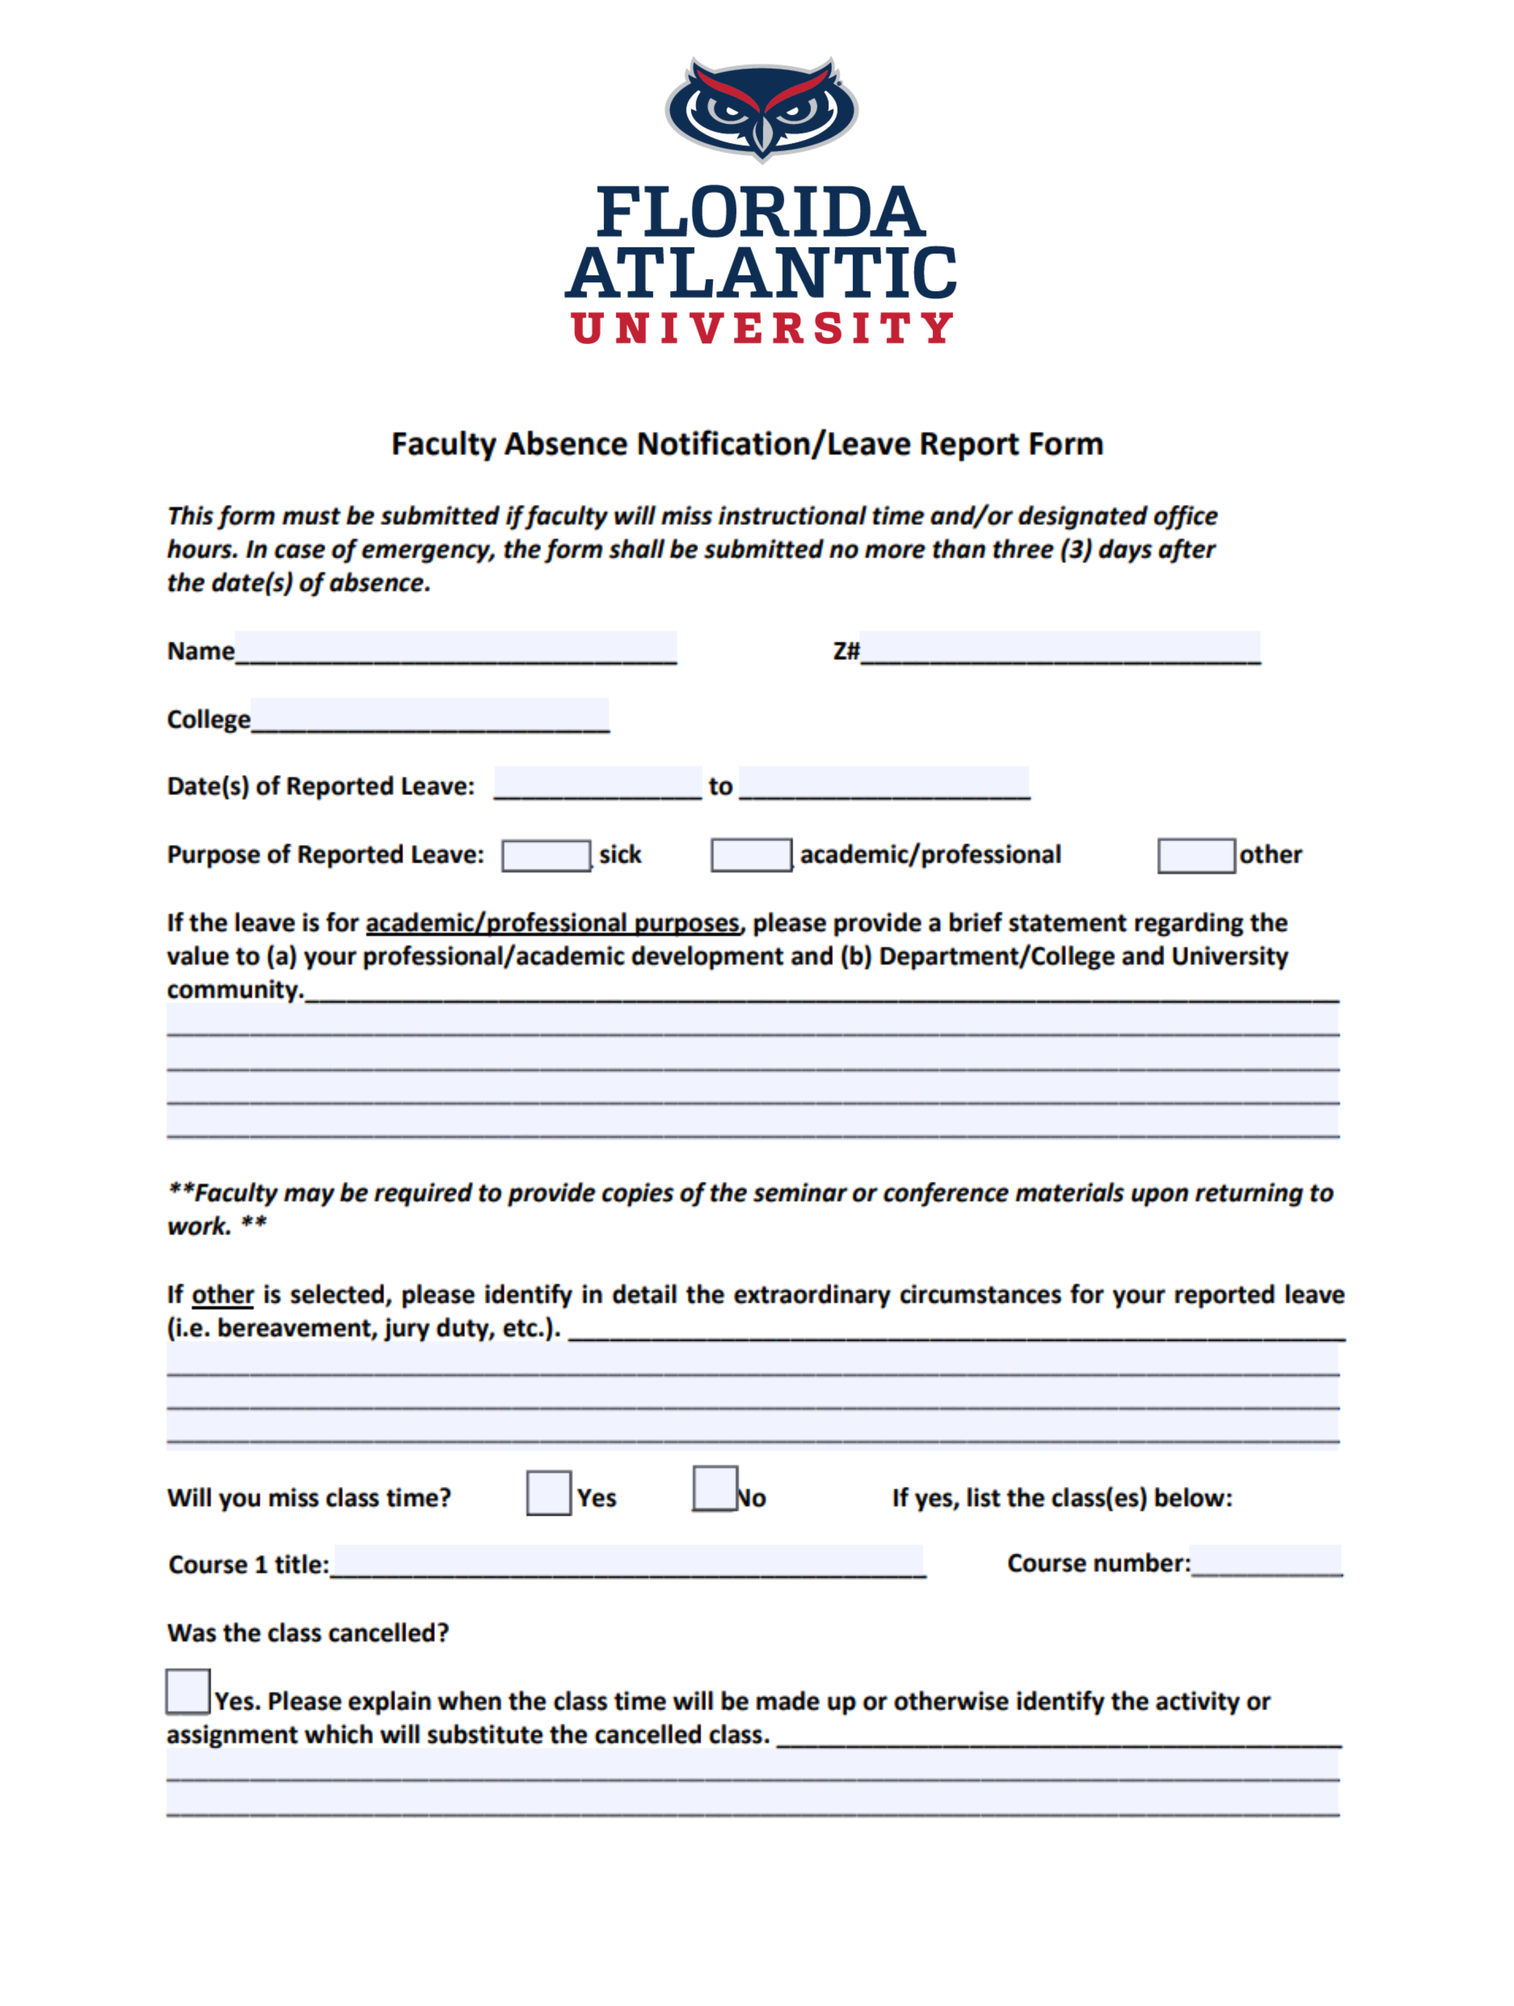
Faculty absence
University Policy 7.5
CBA Article 17
Faculty leave request form
  BOG
  SACSCOC
  Faculty Absence Form

Slide 18

Florida sunshine laws
Florida Statutes, Chapter 286, the “Open Meetings Act,” provides a right of access to governmental meetings.
Florida Statutes, Chapter 119, the “Public Records Law,” creates a right of access to records made or received in connection with official business of a public body.
Refer all public records requests to the Media Relations office
  Requests need not be in writing or directed to any particular individual or office

Slide 19
Florida sunshine laws (cont’d)
Florida Statutes, Chapter 119 defines Public Records as:
  all documents, drafts, emails, texts, papers, letters, maps, books, tapes, photographs, films, sound recordings, data processing software, or other material
    regardless of physical form or means of transmission
  made or received pursuant to law in connection with transaction of official business by the agency
Not applicable to truly personal records

Slide 20
Florida sunshine laws (cont’d)
But, I sent it from my personal email address or device!
  It doesn’t matter where the record originated from.
  If it was made or received in the course of official business and perpetuates, communicates, or formalizes knowledge, it is subject to Florida’s Public Records Law even if sent from a personal email address or device.

Slide 21
Florida sunshine laws (cont’d)
Some public records are exempt from public disclosure due to statutory exemptions.
Examples of exemptions:
  Student education records (FERPA and state law)
  Certain materials relating to faculty tenure applications
  Certain investigative records during the pendency of an investigation
  Certain confidential trade secret or proprietary information

Slide 22
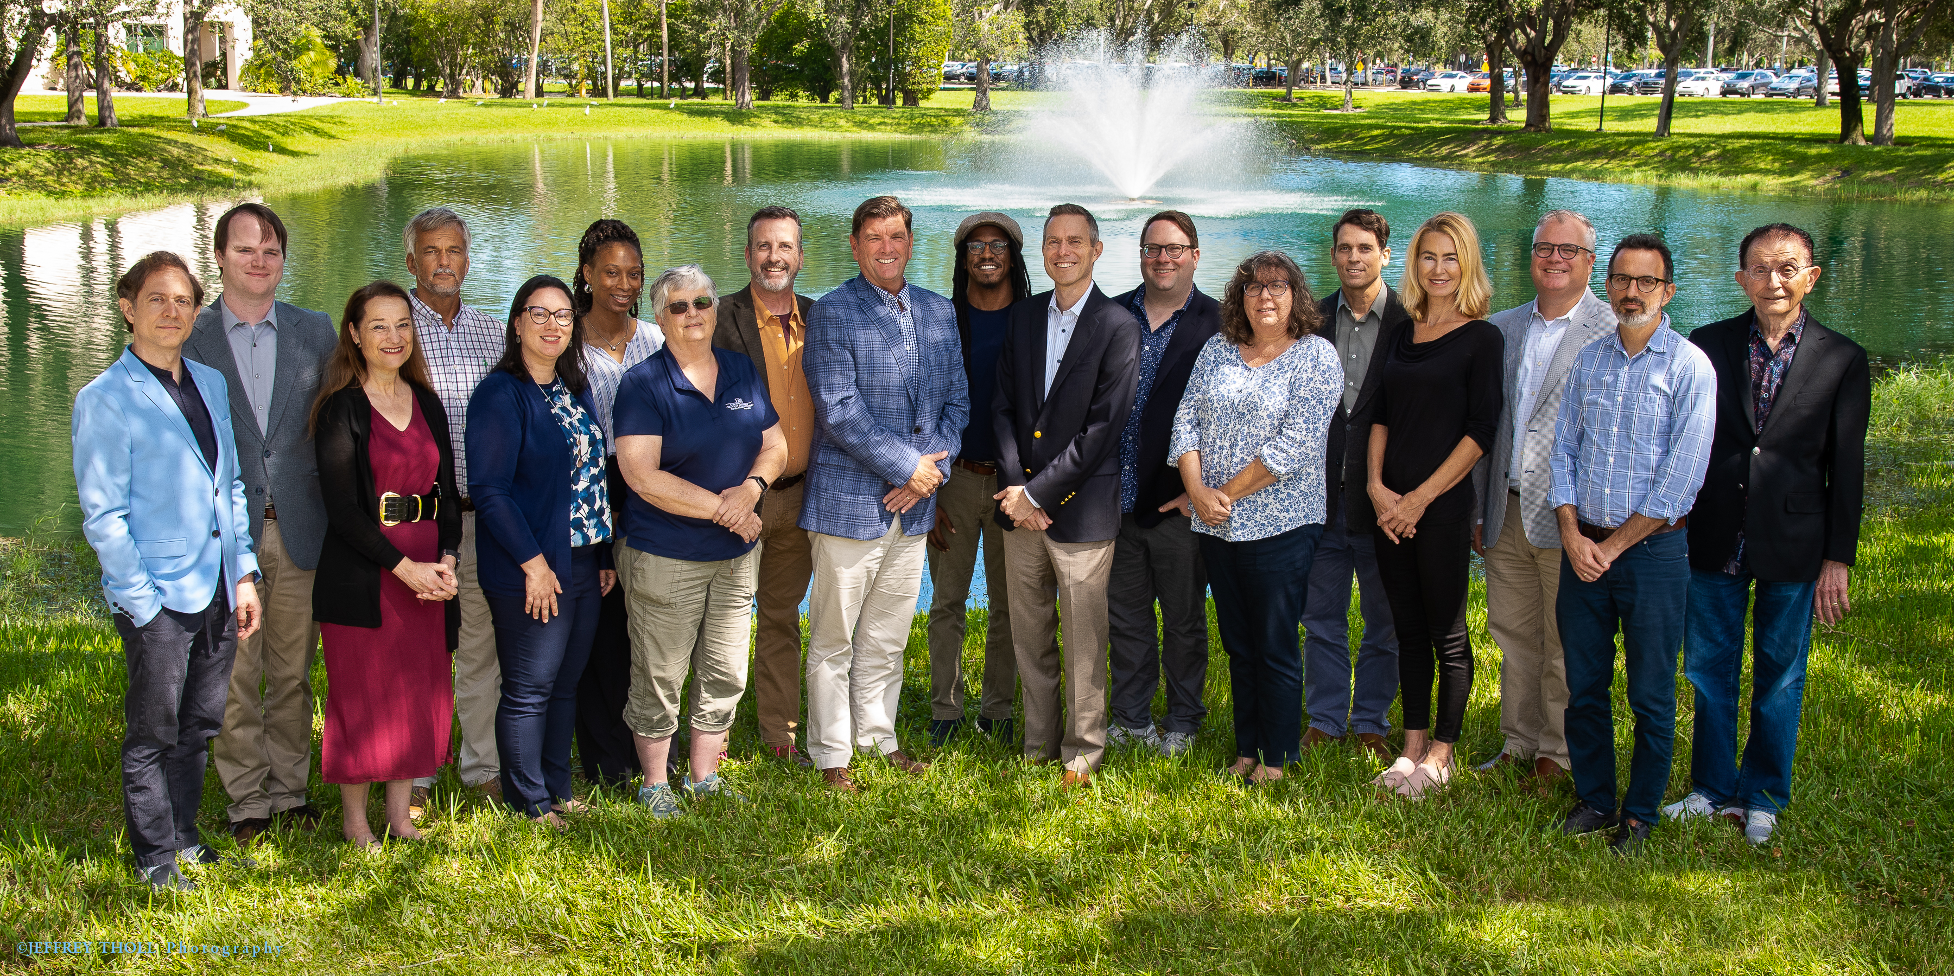
We’re Glad you’re here!

Slide 23
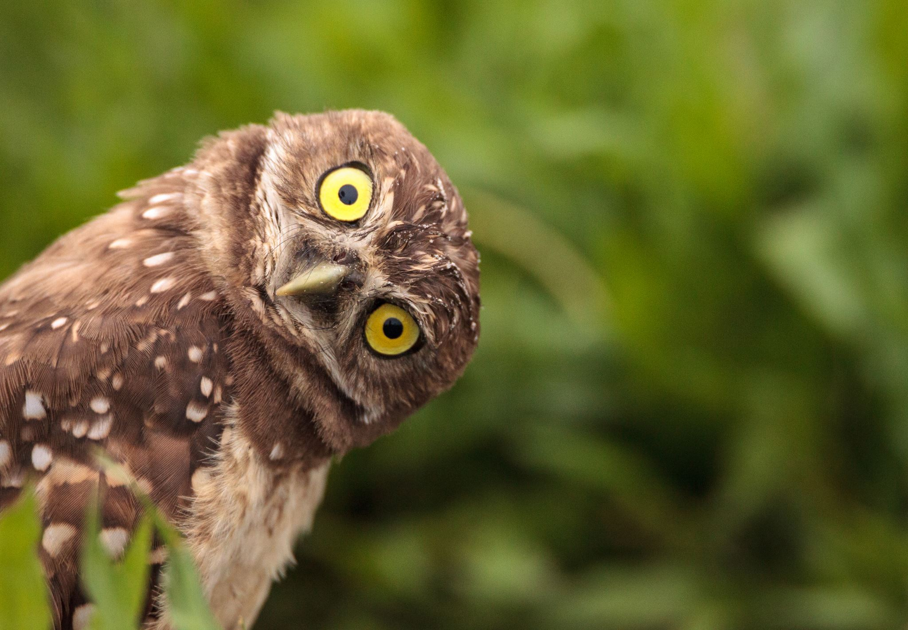
Questions?
QUESTIONS?
Feel free to contact us!
  Office of the Provost
  Tel: 561-297-3062
  www.fau.edu/provost

