Slide 1

OFFICE OF CIVIL RIGHTS AND TITLE IX (OCR9)
MEET AND GREET OCR9

Slide 2


The information presented is important to help all Florida Atlantic University Community Members. The information provides guidance to FAU Students, Employees, and Guests when they become aware of Discrimination and Harassment Incidents. What conduct is prohibited under University Regulation 7.008 and Policy 1.15; understand the available options and supportive measures; and learn methods to respond and report incidents they become aware of.

Slide 3
OFFICE OF CIVIL RIGHTS AND TITLE IX STAFF
Bobby Brown, Executive Director and Title IX Coordinator
Ellie Hyppolite, Associate Director and Deputy Title IX Coordinator
Jennifer Ross, Senior Civil Rights Investigator and Trainer
Irene Salvador-Baltrucki, Civil Rights Investigator and Trainer
Michelle Remmick, Compliance Services Manager
Location: Kenneth R. Williams Administration Bldg.
Phone: 561.297.3004 / Florida Relay System – 800.955.8771
Website: www.fau.edu/ocr9
Online Reporting: www.fau.edu/report

Slide 4
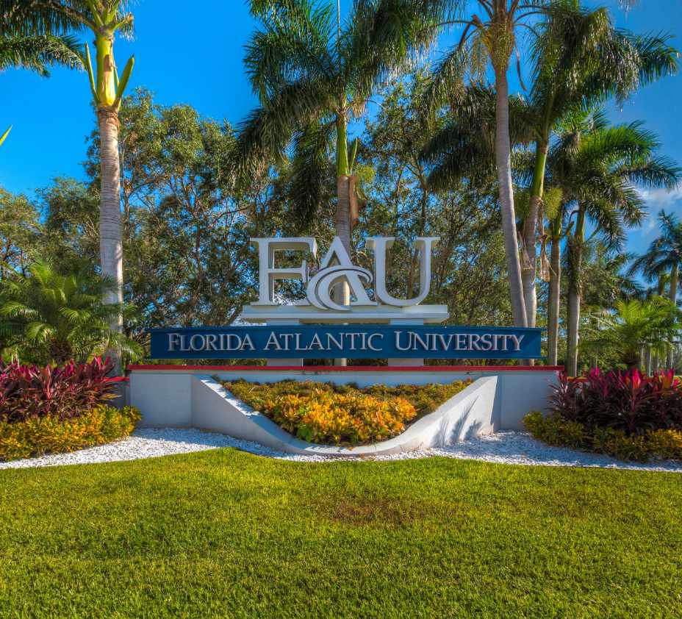
What are FAU’s Applicable Regulation and Policy?
FAU complies with applicable federal, state, and local discrimination/harassment laws
FAU Regulation applies to:
  Students
  Student Organizations
  Faculty/Staff
  Volunteers
  Third Parties Providing Services to FAU
FAU Regulation 7.008
FAU Policy 1.15
  The Regulation and Policy provides information about the reporting and investigating procedures and defines what types of conduct are prohibited
Source: Florida Atlantic University – Regulations and Policies www.fau.edu/policies/policies-regulations/

Slide 5

APPLICABLE FEDERAL LAWS
Applicable Federal Laws: Title II, Title VI and Title VII, Title IX, Pregnancy Act, Fair Housing Act, Clery Act, VAWA, and Campus SaVE Act.
Title II prohibits discrimination in public accommodations based on race, color, religion, or national origin.
Title VI prohibits discrimination based on race, color, and national origin in programs and activities receiving federal financial assistance.
Title VII prohibits employment discrimination based on race, religion, national origin, color, and sex.
Title IX prohibits discrimination based on sex in educational programs and activities.
The Pregnancy Act amended the Civil Rights Act and prohibits sex discrimination based on pregnancy.
The Americans with Disabilities Act prohibits discrimination based on disability.
The Fair Housing Act protects people from discrimination when engaging in housing-related activities.
The Clery Act requires reporting crimes, disclosure of crime statistics, and timely warnings.
Violence Against Women Act Reauthorization Act 2022 (VAWA) addresses sexual assault and gender-based violence, access to safety and support for survivors, and prevention efforts.
Campus SAVE Act (Sexual Violence Elimination Act) requires transparency, guarantees rights for victims of sexual violence, provides certain accommodations, and campus prevention programs.

Slide 6
REGULATION 7.008
“Florida Atlantic University shall comply with applicable federal, state and local discrimination/harassment laws to provide an educational, employment, and business environment free of all forms of discrimination or harassment. Unlawful discrimination or harassment based upon an individual’s race, color, religion, sex, national origin, age, disability, military or veteran status, marital status, pregnancy or parental status, sexual orientation, or other protected status is prohibited. Discriminatory conduct in the form of sexual misconduct, including sexual harassment, sexual assault, domestic violence, dating violence, and stalking, is also prohibited. . . .”

Slide 7
FORMS OF DISCRIMINATION
Disparate Impact: When policies, practices, rules, or other systems that appear to be neutral result in a disproportionate impact on a protected group. The disparate impact may be unintentional.
Disparate Treatment: When a person is treated differently from others who are similarly situated, the difference is based on a protected characteristic, and the person was denied a benefit under FAU’s educational program or activities or a benefit of employment.

Slide 8
HARRASSMENT
Harassment is a form of Discrimination -
Harassment can take the form of slurs, graffiti, offensive or derogatory comments, or other verbal or physical conduct.
Harassment is illegal if it is so frequent (pervasive) or severe that it creates a hostile or offensive work environment or if it results in an adverse employment decision (such as the victim being fired or demoted).
The harasser can be the victim's supervisor, a supervisor in another area, a co-worker, or someone who is not an employee of the employer, such as a client or customer.
Harassment outside of the workplace may also be illegal if there is a link with the workplace. For example, if a supervisor harasses an employee while driving the employee to a meeting.
Although the law does not prohibit simple teasing, petty slights, annoyances, offhand comments, or isolated incidents that are not very serious, do not rise to the level of illegality.

Slide 9
HOSTILE ENVIRONMENT
A Hostile Environment creates an objectively intimidating, hostile, or offensive work or educational environment.
When another individual’s conduct makes it difficult or uncomfortable for people to work or get their education, then a Hostile Environment may be present.
Hostile Environment can have the effect of subjecting an Individual or Group to the following:
When the conduct interferes with or limit their ability to participate in services, activities, or privileges provided by the University.

Slide 10
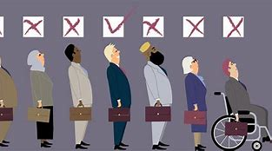
TYPES OF DISCRIMINATION AND HARASSMENT
Age Discrimination
Disability Discrimination
Sexual Orientation Discrimination
Status as a Parent / Pregnancy
Religious Discrimination
National Origin Discrimination
Sexual Harassment/Sexual Misconduct
Race or Color Discrimination
Retaliation / Reprisal
Bullying (if based on a protected class)

Slide 11
WHAT CAN SEX DISCRIMINATION LOOK LIKE?
  Sex Based: Derogatory or demeaning jokes, slurs, epithets or name-calling, intimidation, mockery, ridicule, insults/put-downs, and mockery about women and men / Stereotypes and beliefs about women and men, offensive objects/pictures. Also, failure to conform to sex stereotypes, including derogatory remarks, or gender discrimination in activities, or other hateful conduct about an individual’s actual or perceived sexual orientation
  Sexual Harassment: Unwelcome conduct of a sexual nature - unwelcome sexual advances, requests for sexual favors, and other verbal, nonverbal, or physical conduct of a sexual nature; other examples that are considered forms of sexual harassment include stalking, obscene phone calls/communications, sexually suggestive jokes, inappropriate touching, or intimidation
  Sexual Violence: Rape, sodomy, statutory rape, incest, fondling, sexual assault, sexual battery, sexual abuse, and sexual coercion. Also included are Dating Violence, Domestic Violence, and Stalking are now covered by Title IX and are generally associated with Sexual Violence

Slide 12
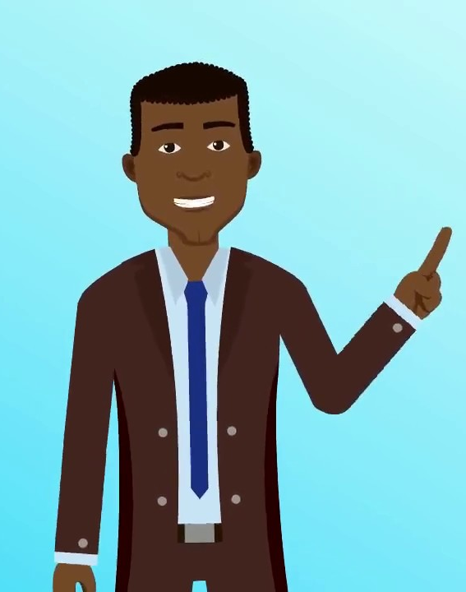
What is the University’s Intake Process?
How are Reports Received?
Via Maxient, Phone Call, Email, In Person
How are Reports Reviewed?
Complete Intake Assessment
  Determine whether the alleged conduct is within OCR9’s scope
  Determine whether conduct if substantiated would constitute conduct prohibited by the University policy
Complete Safety Risk Assessment
  Determine what action is necessary or permissible that may address the allegations
Provide information about available options
  Provide information about victim advocate
  Discuss availability of supportive measures with or without filing a complaint
  Consider Complainant’s request for supportive measures
  Provide information about investigative rights and options

Slide 13
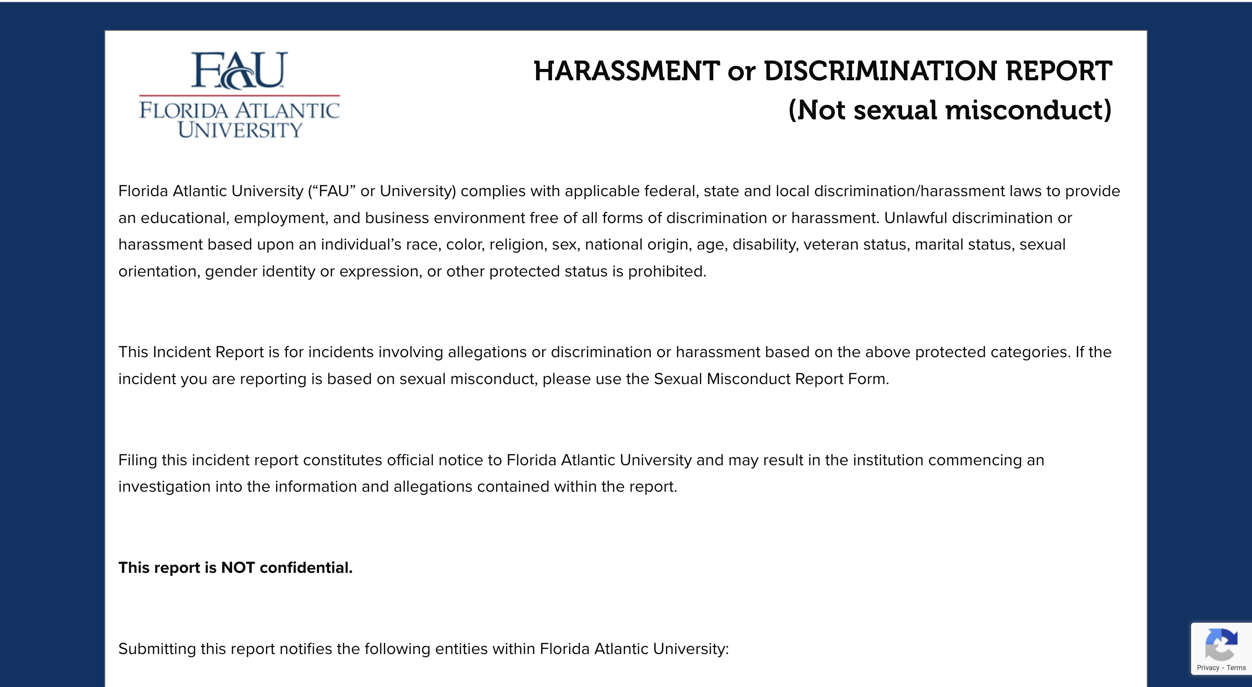

Slide 14
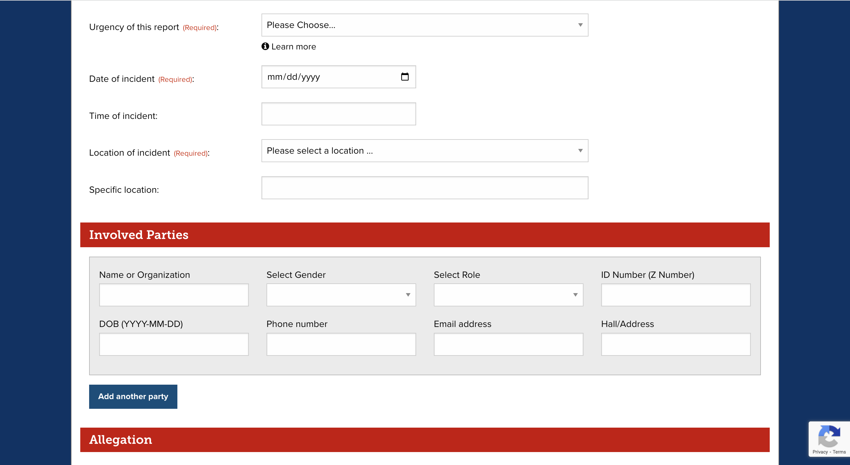

Slide 15
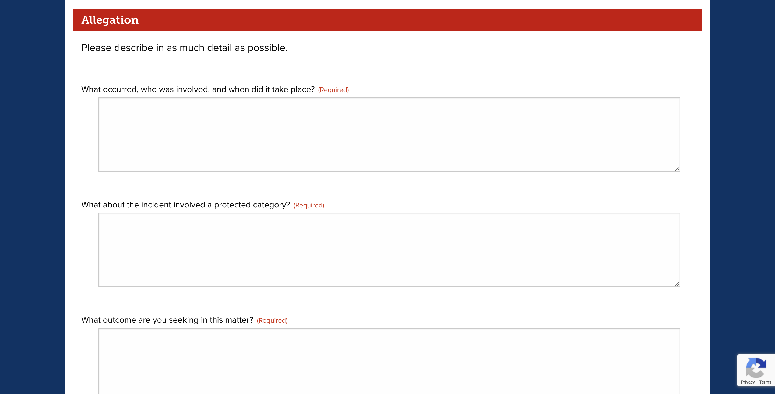

Slide 16

What is the University’s Investigation Process?
Complaint received
  Determine whether the alleged conduct is within the scope
  Determine whether mandatory dismissal apply
  Determine if there are safety/risk concerns
Complaint accepted
Notice of Allegations is sent
  Sufficient details about the allegations provided
  Identities of parties provided
  A statement that Respondent is presumed not responsible for the alleged conduct
Rights of Complainant and Respondent explained
Supportive Measures Implemented
Investigation
  Seventy-five (75) calendar timeframe (can be extended)
  OCR9 is neutral (we are required to gather exculpatory and inculpatory evidence)
  The university has the responsibility of gathering evidence/burden of proof
Parties review the OCR9 investigation file (TIX Cases)
Title IX Hearing Held or Determination Findings Issued and Transferred

Slide 17
SUPPORTIVE MEASURES
Supportive Measures are supportive services that are non-disciplinary, non-punitive, and individualized services. The University is required to offer supportive measures after receiving notice of possible violations of discrimination and harassment policies (i.e., Title VI, Title VII, Title IX, VAWA).
Supportive measures must be offered to individuals (i.e., employees and students) involved in OCR9 investigations.
Faculty should trust the Title IX Coordinator and Victim Services have reviewed/verified the request for supportive measures.
Faculty must offer supportive measures commonly known as academic support to students involved in Title IX reports.
Examples of supportive measures can include:
No / Limited contact directive
Counseling services
Campus Escort services
Changing office location or classroom seating
Academic supportive measures can include:
Amending attendance policy (excusing absences)
Providing students with make-up dates for missed assignments
Extending deadlines or providing alternative dates to take exams
Allowing students to complete exams outside the class in a controlled setting (i.e., with a proctor)

Slide 18
WHO CAN HELP AT FAU?
Victim Services
  Provide services designed to help Victims/Complainants navigate available campus support options.
Respondent Services
  Provide services designed to assist Students who are Respondents in Conduct Cases.
The Office of Civil Rights and Title IX (OCR9)
  Provide services for the University Community regarding Sex Discrimination.
University Counseling and Psychological Services (CAPS)
  Provide Confidential Counseling Services for University Students.
University Health Services
  Provide Medical Care Services for University Students.
Dean of Students Office
  Provide help for University Students managing crises and life traumas.
The Office of the Ombuds
  Assist individuals seeking help to solve problems, allay frustration, and advice to those requesting help.
University Human Resources (Employee Relations)
  Provide employment services for University Employees dealing with workplace issues.
Florida Atlantic University Police Department
  Provide public safety services to the University Community.

Slide 19
WHAT IS BYSTANDER INTERVENTION?
You may have heard the phrase bystander intervention.
If you have not, at some point or time, you have stepped in and assisted someone in need of help, especially if you noticed someone experiencing behavior you thought was not appropriate.
For Instance:
Maybe you’ve stopped your coworkers or friends from arguing or fighting;
Maybe you’ve spoken up against something you thought was wrong (discrimination/harassment);
Maybe you’ve called EMS or the Police when someone was involved in an accident;
Maybe you’ve checked on someone after an accident or after they left the hospital.
If so, then you have used strategies associated with Bystander Intervention.

Slide 20
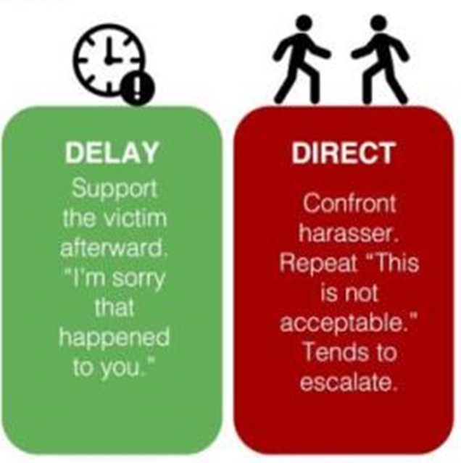
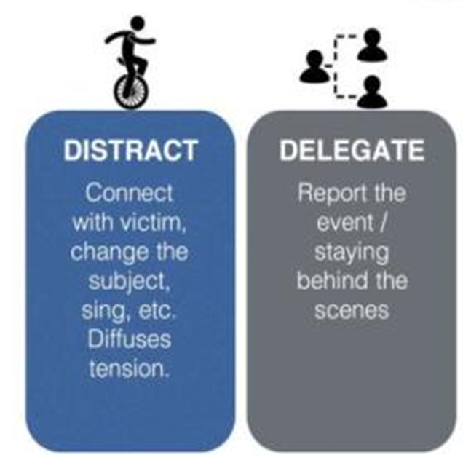
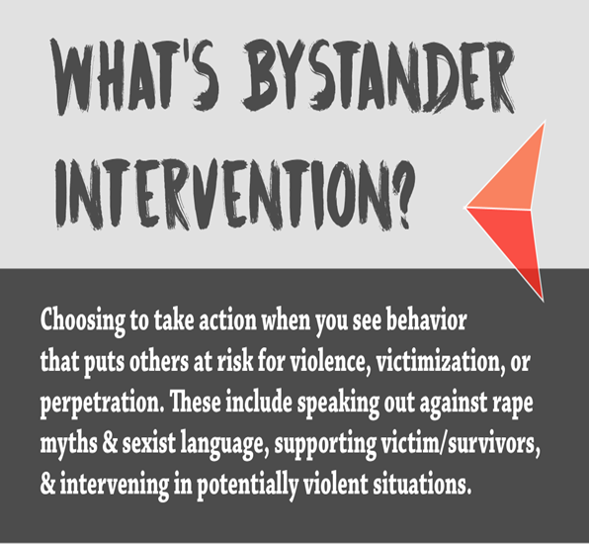
BYSTANDER INTERVENTION

Slide 21
INTERVENE OR NOT?
Bystander Intervention is all about how to overcome acting passively when people need help.
Acting passively and choosing not to intervene can occur:
When people stand around witnessing an incident, and no one intervenes.
The thought that it is someone else’s responsibility to intervene.
It is common for people to pass the responsibility to others.
When no action is taken to stop the incident, the message conveyed is that the behavior is acceptable.
Therefore, it is incumbent upon all Florida Atlantic University Community members to do our part and intervene when someone is in trouble.
We encourage all FAU Owls to become Active Bystanders Against Discrimination, Harassment, and Violence in the FAU community!

Slide 22
OWL BE THERE!
Know they can help prevent misconduct
Listen with a non-judgmental ear
Look out for their fellow Owls when they’ve had too much to drink
Speak out when discrimination and harassment occurs in the University community
Educate themselves and others about appropriate campus conduct and avoiding unsafe situations
Intervene when a person tries to take advantage of someone
Help Fellow Owls get out of potentially dangerous situations
Seek help when they see a fellow Owl in trouble or danger

Slide 23
KEY TAKEAWAYS
Know the University Policies that Apply to You.
Always Follow the Policy - “Do What’s Right, Not What’s Easy.”
Treat University Community Members with Respect.
Don’t intimidate, manipulate, or threaten University Community Members.
Don’t use verbally abusive language when speaking to University Community Members.
Don’t engage in physically abusive conduct toward University Community Members.
Remember, anyone can experience Discrimination and Harassment.
Remember, Discrimination and Harassment come in different forms.
Remember to Respect People’s Individual Differences.
OCR9 is the office responsible for responding to reports about discrimination, harassment, and retaliation based on protected categories.
OWL Be There - Always Be a Proactive Owl Bystander
Report incidents that you witness or receive information about. Don’t presume someone else has reported the incident!
Remember to support individuals who disclose incidents to you.
Providing supportive measures is a statutory requirement.
Submitting a report to OCR9 DOES NOT initiate an Investigation. A complaint must be filed.
If you don’t know what to do – call OCR9!
Remember Your Choices Have Consequences!

Slide 24

Any Questions

